Slide 1
Prototyping ChatBot Scheduler
The best and the easiest way for scheduling your meetings!
By Group3 Members-
Bhargav Thanki (U61740997)
Mounika Kancharla (U32382360)
Natasha Gandhi (U25537078)
Sreekanth Cherapati (U48493684)

Slide 2
Index
Project Objective
Problem Statement
Target Audience
Assumptions
Project Timeline
Technology Stack
System Flow
User Interfaces
Proposed architecture
Conclusion
References
Demo of prototype

Slide 3
Project objective
Frustrated with back and forth mails for scheduling meetings?
Time to find a simpler solution!

Slide 4
Problem Statement
To develop a working prototype of a chatbot scheduler with the ability to book a meeting/appointments with a person/group of people with popular calendar applications.
Use FaceBook Messenger for chatting
Use Calendars like Google Calendar
Bot should schedule meeting for users and confirm back!

Slide 5
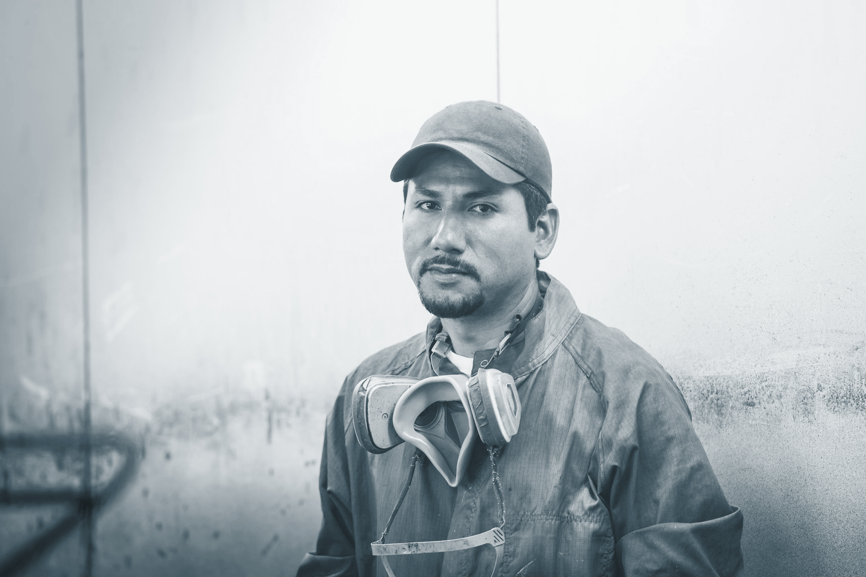

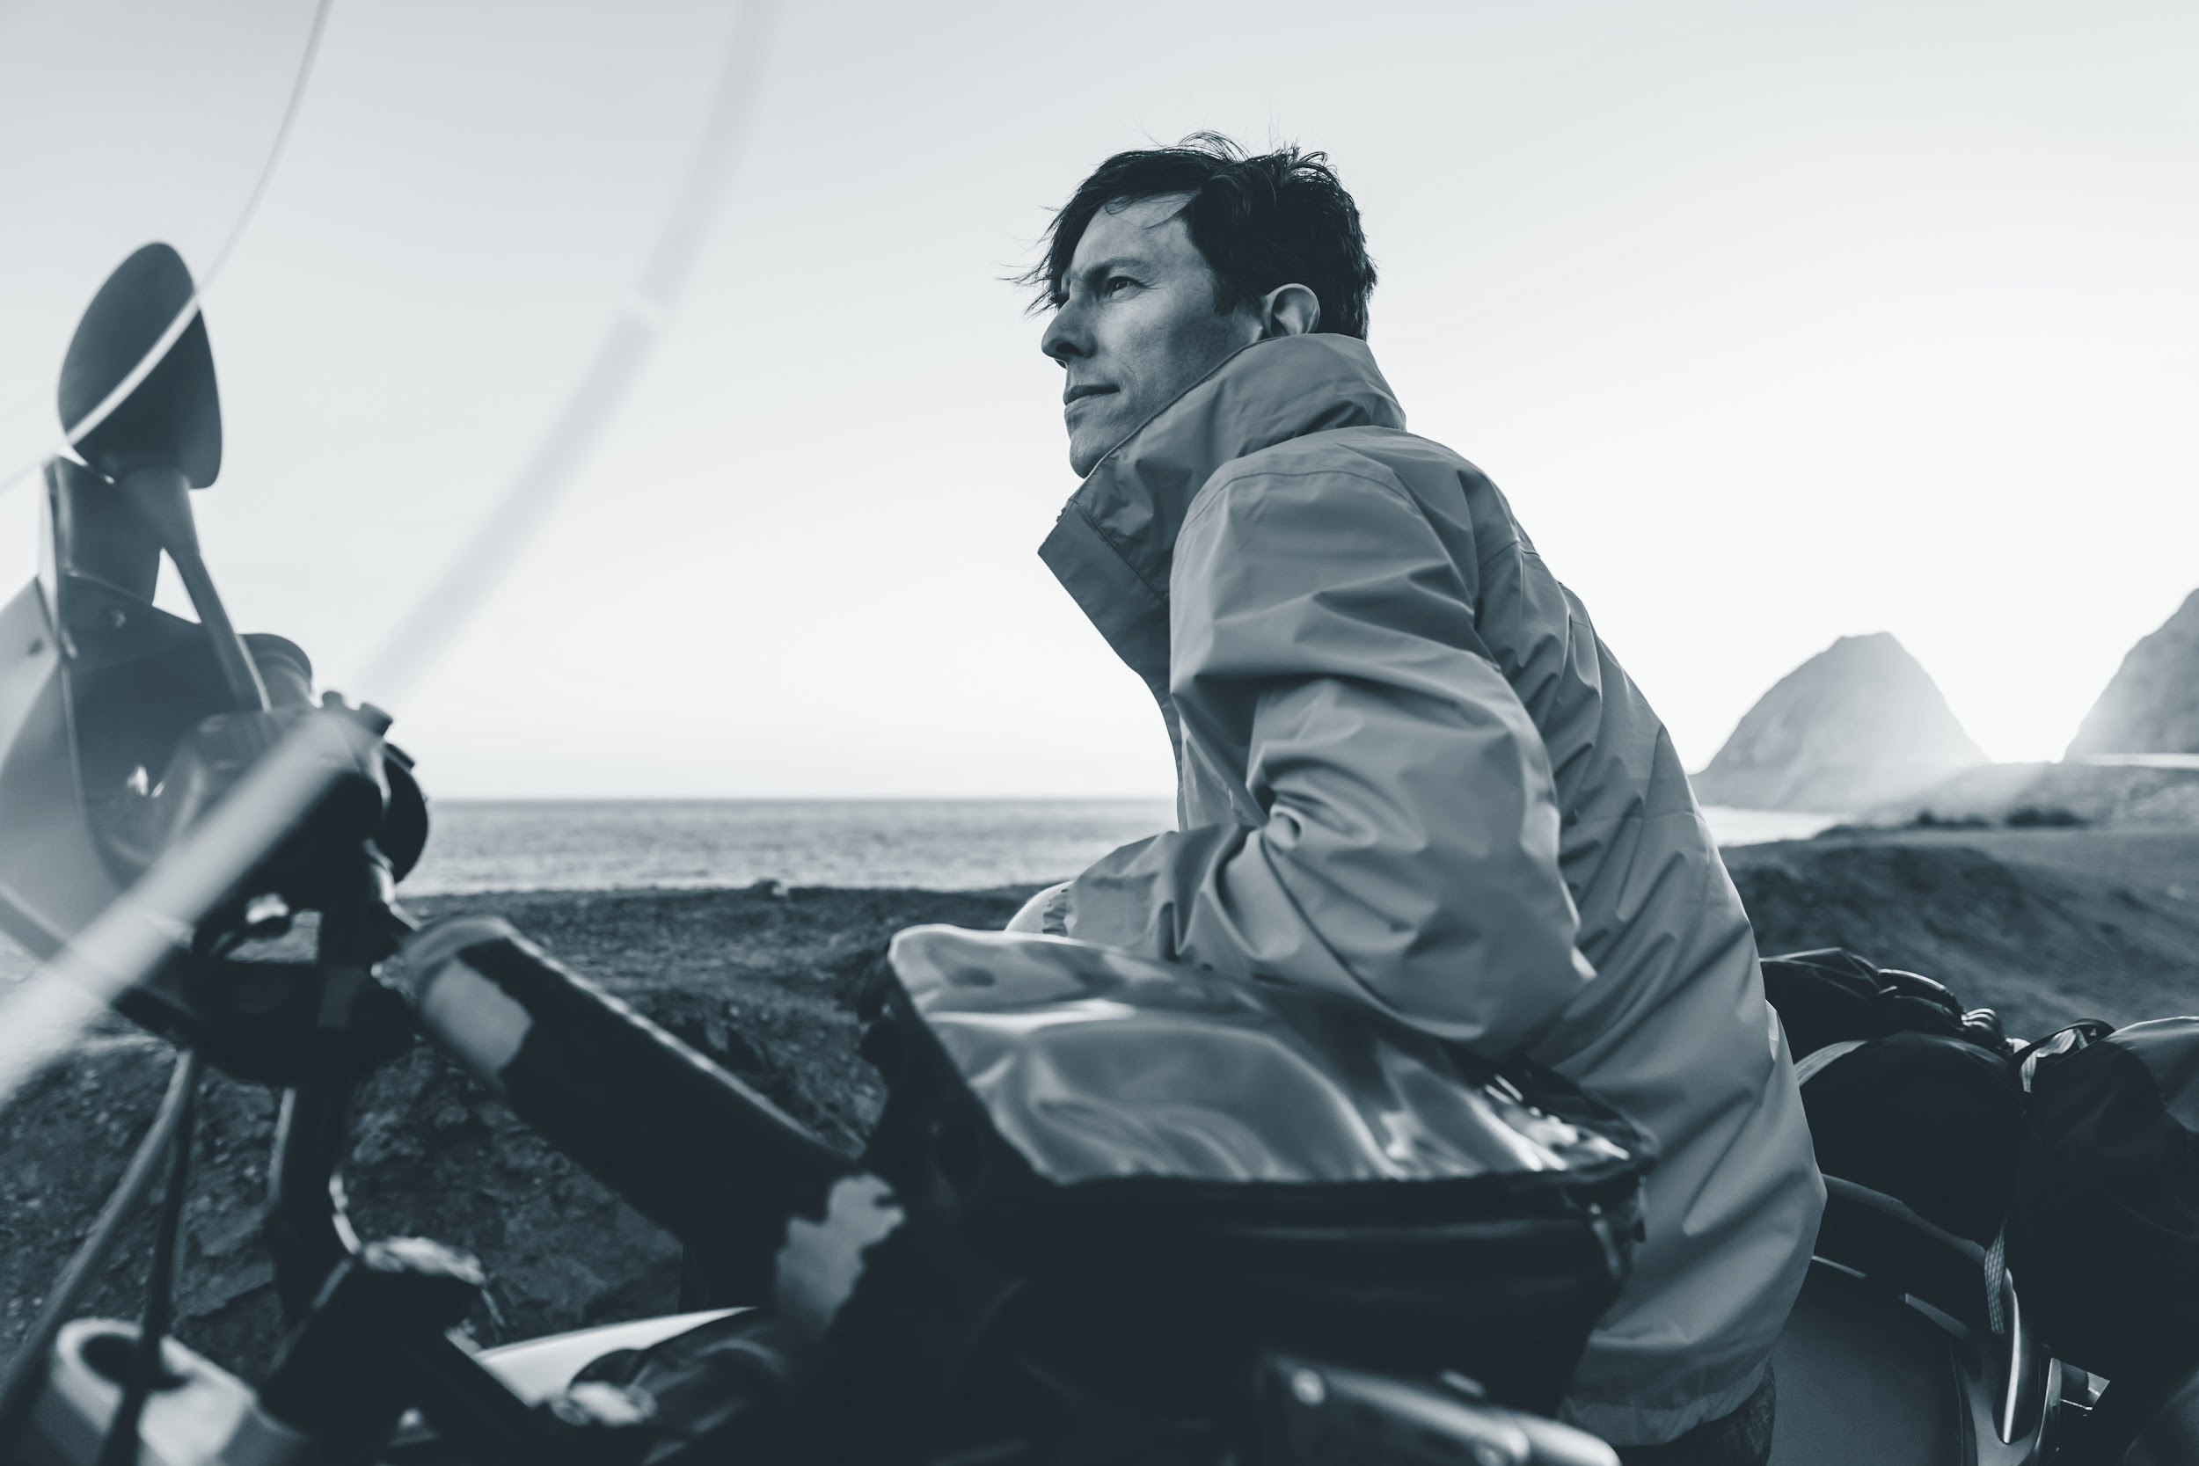
Target Audience
Business people
IT professionals
Doctors
…….
Anyone and Everyone who registers to our system!!!

Slide 6
Assumptions- for the prototype….
To use this chatbot application, users need to be registered to our system
For registering, there would be a web application form
Users should give authorization of their respective calendars
Users should have enabled sharing of their events in calendars

Slide 7
Project timeline
AUG
SEPT
OCT
NOV
DEC
2017
Group Formation
Architecture and Technology Stack
Prototype ready
Problem Statement and Solution Design
Development and Testing

Slide 8
Technical Stack
APIs- DialogFlow (previously known as API.ai)
Cloud Application Platform- Heroku Platform
Middleware- Python
Database- MySQL
Web Services- AWS RDS
Calendar- Google Calendar API

Slide 9
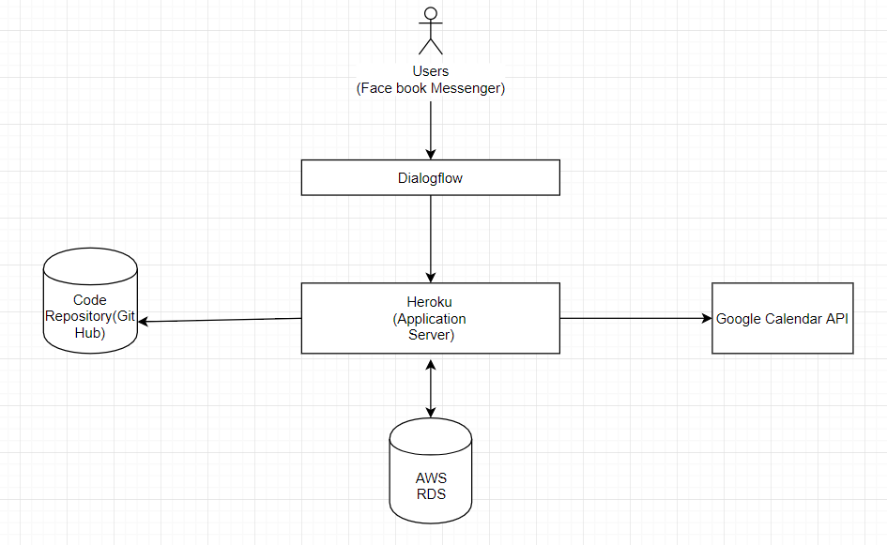
System Flow

Slide 10
User Interfaces

Slide 11
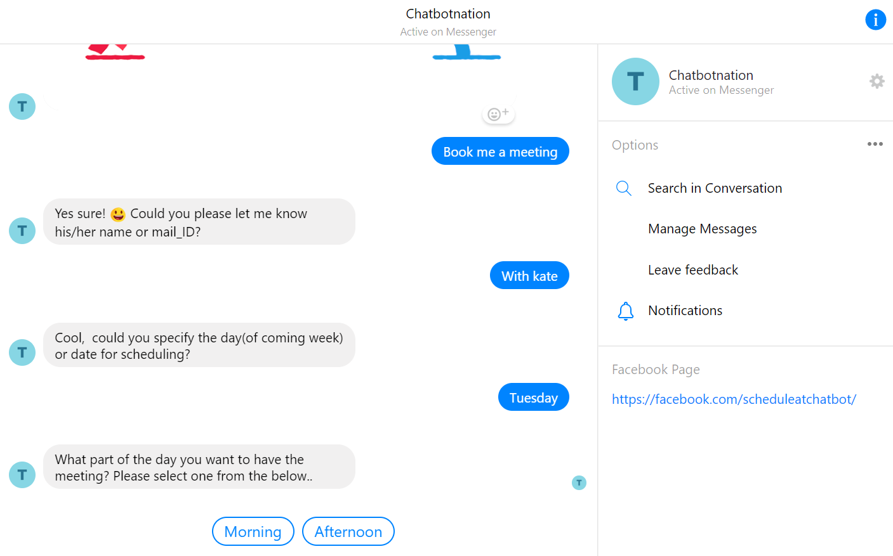

Slide 12
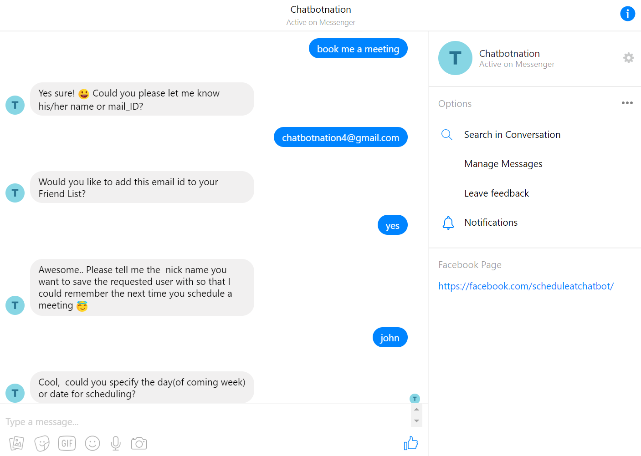

Slide 13
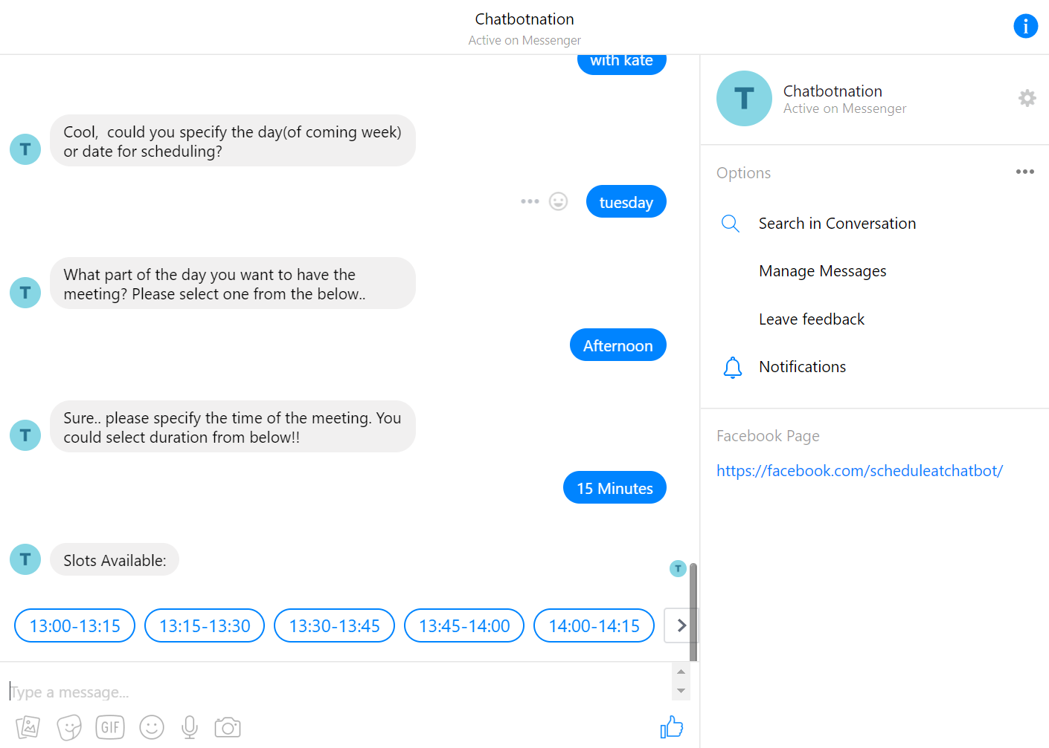

Slide 14
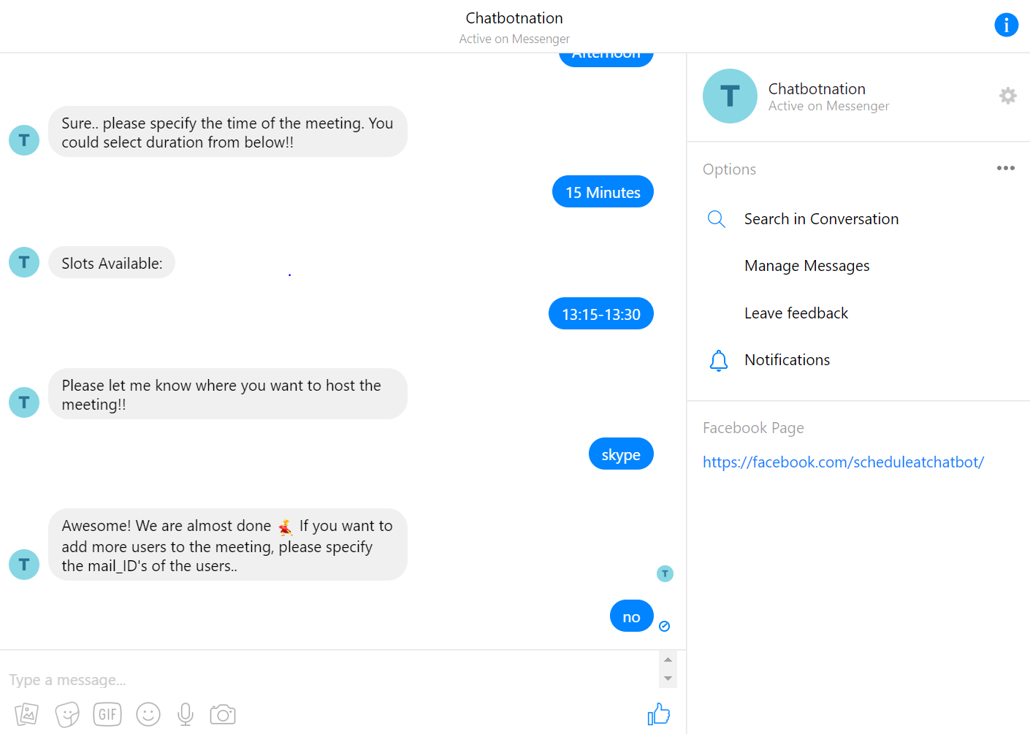

Slide 15
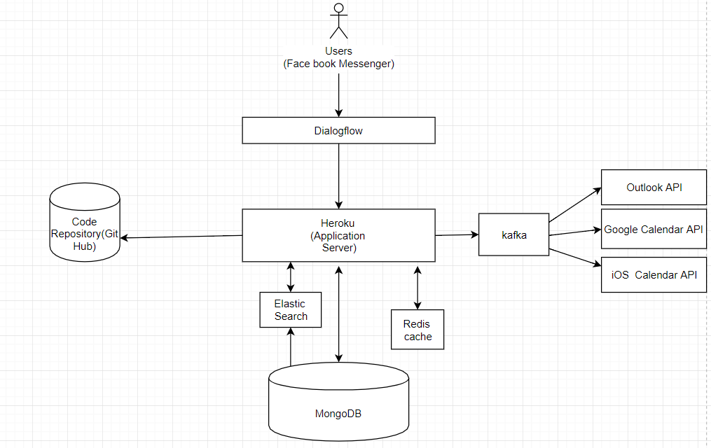
Proposed Architecture- for Scalabilty….

Slide 16
Conclusion
No need for back and forth mails to schedule an appointment!
Chatbot is here to assist you in booking meetings for you, at your convenience, with the people you want, and the calendars they have!
Have a look at the Prototype Developed for Chatbot at the end!

Slide 17
References
https://developers.google.com/google-apps/calendar/quickstart/python
https://developers.google.com/google-apps/calendar/
https://dialogflow.com/docs/fulfillment
https://dialogflow.com/docs/integrations/facebook
http://www.rmunn.com/sqlalchemy-tutorial/tutorial.html
http://flask.pocoo.org/
https://www.fullstackpython.com/flask.html

Slide 18
Thank you!

